Slide 1

Data Structures and Algorithms Instructor: Maira Sami
maira.sami@szabist.edu.pk
Campus 154
CUBICAL 02- Ground floor

Slide 2
LECTURE# 01 INTRODUCTION TO DATA STRUCTURES AND AGORITHMS

Slide 3
Course Overview
Course
Class Timings
Grading
Attendance
What to Avoid
Keys to Success
Syllabus / Topics

Slide 4
Course credit hours
Data Structure and Algorithms (04 credit hours course)
1 class per week (2.5 hours)
Teaching/ Learning methodology
Lectures
Examples/ scenarios
Readings and Assessments
Class Discussion and Student Participation

Slide 5
Marking Head
Theory Mid-Term – 8th /9th Week ( To be communicated before exams)
Theory Final-Exam
16th Week
Quizzes = 2
5th Week
12th Week
Assignments
(* might be change)

Slide 6
Assignments:
Must be submitted on or before the due date and time. Late submissions will not be accepted. An assignment copied from a student or any other source will receive an F grade

Slide 7
Marks Head | Total Frequency | Marks / Frequency
Midterm Exam | 1 | 15
Final Exam | 1 | 60
Quizzes | 2 | 5
Assignment | 2 | 5
Proj | 1 | 5

Slide 8
What to avoid?
Late coming
Use of Mobile phones during lecture
Strictly prohibited
Disturbing others during lecture
Plagiarism

Slide 9
Book(s)
Data structure (Schawn outline series)
Data Structure with C++ (William ford)

Slide 10
Syllabus
Logic Building, Flowcharting and Pseudo code development
Introduction to Abstract Data Types, basic terminology Data structure operations, algorithms, space and time complexity Review of basic mathematical and programming background
Arrays: one D, 2D and 3D, Traversal, insertion and deletion
Representation in memory, Row Major Column Major and C++ representation Records and Structures
Linked Lists, Linked List Operations
Stacks and Queues
Priority Queues through Heaps

Slide 11
Syllabus
Binary Tree, Linked Representation of Binary Trees, Insertion and Deletion, Traversal of Binary Trees (In order, Post order and Pre Order) Post Fix and Infix notations
Binary Search Trees, Insertion and Deletion
Graphs, Graph representation, Graph traversal algorithms, Searching algorithms
Searching, Linear Search, Binary Search
Sorting Algorithms

Slide 12
What is it all about?
Using a computer to help solve problems
Designing programs (architecture, algorithms)
Writing programs
Verifying programs
Documenting programs
Notes:
An example of manual Problem solving is like building a house…1st sketch is made like designing programs phase in computer science…Then that structure is worked out, similar to writing programs and then after building it must be checked for confirmation like program testing and finally it is documented…

Slide 13
Data Structures and Algorithms
A famous quote: Program = Algorithm + Data Structure
Algorithm
Finite sequence of steps for solving a particular problem
Program – an implementation of an algorithm in some programming language
Data structure
Organization of data needed to solve the problem
Notes:
Data is any color name number , but after processing it become informATION
No. → processing → contact num

Slide 14
Algorithm Specification
Introduction
An algorithm is a finite set of instructions that accomplishes a particular task.
Criteria
input: zero or more quantities that are externally supplied
output: at least one quantity is produced
definiteness: clear and unambiguous
finiteness: terminate after a finite number of steps
effectiveness: instruction is basic enough to be carried out
Notes:
As we drive… while driving your input is speed and output is miles you travel.. Roads should be clear and finiteness not endless..

Slide 15
Algorithm Specification
Representation
A natural language, like English or Chinese.
A graphic, like flowcharts.
A computer language, like C.

Slide 16
Algorithm Analysis
Foundations of Algorithm Analysis and Data Structures.
Analysis:
How to predict an algorithm’s performance
How to compare different algorithms for a problem
Data Structures
How to efficiently store, access, manage data
Data structures effect algorithm’s performance
Notes:
Analysis means to compare different solutions for a single problem/task

Slide 17
Example Algorithms
Two algorithms for computing the Factorial
Which one is better?
int factorial (int n) {
if (n <= 1) return 1;
else return n * factorial(n-1);
}
int factorial (int n) {
if (n<=1) return 1;
else {
fact = 1;
for (k=2; k<=n; k++)
fact *= k;
return fact;
}
}
Notes:
There are different criteria's in order to evaluate the performance of any product. For example for a mobile phone some people want simple mobile, while others have their own measures.. For comparison of algorithms One simplest matrix is LOC.. A program with fewer number of lines is more efficient as it takes small amount of memory, fast, and easy to remove bugs…

Slide 18
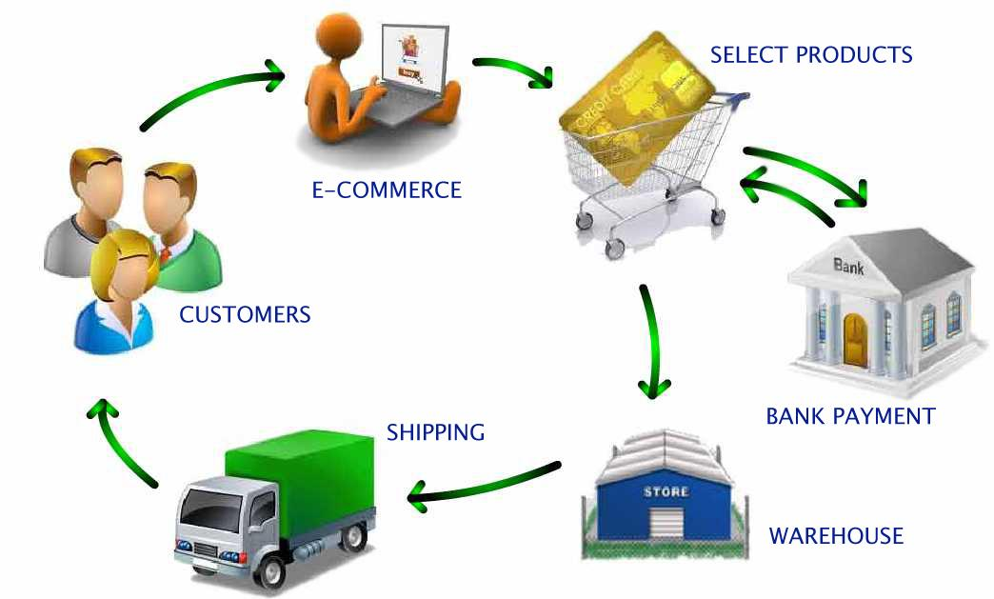
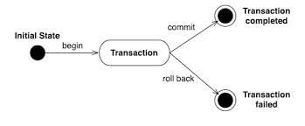
Role of Algorithms in Modern World
Enormous amount of data
E-commerce (Amazon, Ebay)
Network traffic (telecom billing, monitoring)
Database transactions (Sales, inventory)
Scientific measurements (astrophysics, geology)
Sensor networks. RFID tags
Bioinformatics (genome, protein bank)

Slide 19
Overall Picture
Data Structure and Algorithm Design Goals
Implementation Goals
Correctness
Robustness
Adaptability
Efficiency
Reusability

Slide 20
Overall Picture (2)
This course is not about:
Programming languages
Computer architecture
Software architecture
Software design and implementation principles
Issues concerning small and large scale programming

Slide 21
Algorithmic problem
Specification of output as a function of input
Specification of input
?
Infinite number of input instances satisfying the specification. For example:
A sorted, non-decreasing sequence of natural numbers. The sequence is of non-zero, finite length:
1, 20, 908, 909, 100000, 1000000000.

Slide 22
Algorithmic Solution
Input instance, adhering to the specification
Algorithm
Output related to the input as required
Algorithm describes actions on the input instance
Infinitely many correct algorithms for the same algorithmic problem

Slide 23
Example: Sorting
INPUT
sequence of numbers
OUTPUT
a permutation of the sequence of numbers
Sort
a₁, a₂, a₃,….,a_{n}
b₁,b₂,b₃,….,b_{n}
2 5 4 10 7
2 4 5 7 10
Correctness
For any given input the algorithm halts with the output:
b₁ < b₂ < b₃ < …. < b_{n}
b₁, b₂, b₃, …., b_{n} is a permutation of a₁, a₂, a₃,….,a_{n}
Running time
Depends on
number of elements (n)
how (partially) sorted they are
algorithm

Slide 24
Analysis of Algorithms
Efficiency:
Running time
Space used

Slide 25
How to Measure Algorithm Performance?
What metric should be used to judge algorithms?
Length of the program (lines of code)
Ease of programming (bugs, maintenance)
Memory required
Running time
Running time is the dominant standard.
Notes:
Quantifiable and easy to compare
Often the critical bottleneck

Slide 26
Introduction to Data Structures
What is data?
Data → processing → information
Information is meaningful form of data
Notes:
Data are values or a set of values
Collection of data are frequently organized into a hierarchy of fields, records and files
Storage , retrieval, transformation

Slide 27
Data Structures
Field
is a single elementary unit of information representing an attribute of an entity
Record
is the collection of field values of a given entity
File
is the collection of records of the entities in a given entity set
Name | Age | gender | Roll Number | Branch
A | 17 | M | 109cs0132 | CSE
B | 18 | M | 109ee1234 | EE
C | 19 | F | 109ce0012 | CE
D | 20 | F | 108mm0132 | MM

Slide 28
Data Structures
Entity
Something that has certain attributes or properties which may be assigned values
Values may be numeric or non-numeric
The employee of an organization
Attributes Name Age gender Employee Code
Values John 33 M 3472

Slide 29
Data Structures
Entity Set
Entity with similar attributes ( e. g all employees of an organization) form an entity set
Each attribute of an entity set has a range of values [ the set of possible values that could be assigned to the particular attribute]
Information: Data with given attribute or processed data

Slide 30
Data Structures
Record
Record may be of fix and variable length
Fixed Length Record
All records contain the same amount of data items with the same amount of space assigned to each data item
Variable Length Record
File records may contain different lengths.
e.g student record usually have variable lengths .since different students take different number of courses
Usually variable length records have a minimum and a maximum length
Notes:
“The data structures deal with the study of how the data is organized in the memory, how efficiently it can be retrieved and manipulated and the possible ways in which different data items are logically related”.

Slide 31
Data Structures
A data structure is a scheme for organizing data in the memory of a computer.
The way in which the data is organized affects the performance of a program for different tasks.
Computer programmers decide which data structures to use based on the nature of the data and the processes that need to be performed on that data.
They can be classified in to
Primitive data structures
Non primitive data structure.

Slide 32
Primitive data structure
Basic data types that are available in most of the programming languages. The primitive data types are used to represent single values.
Primitive types are also known as built-in types or basic types.
In C language, the different primitive data structures are int, float, char, double.
Non primitive data structures
The data types that are derived from primary data types are known as non-Primitive data types. These data types are used to store group of values.
Arrays, linked lists, files etc., are some of non-primitive data structures and are classified into linear data structures and non-linear data structures.
Notes:
These are data structures that can not be manipulated directly by machine instructions. (NPDS)

Slide 33
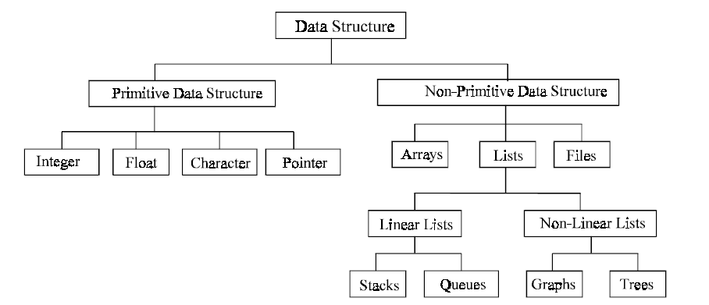
Classifications of Data Structures

Slide 34
Two parts of Data structure
Linear DS (elements present in series) | Nonlinear DS (elements are not in series)
Array | Tree
Stacks | Graph
Queue | Sets
Linked list | tables
Notes:
Complicated DS: neural nets, semantic DS, search graph etc

Slide 35
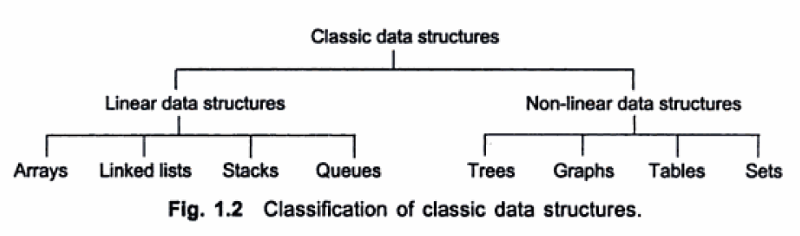
Data Types & Data Structure

Slide 36
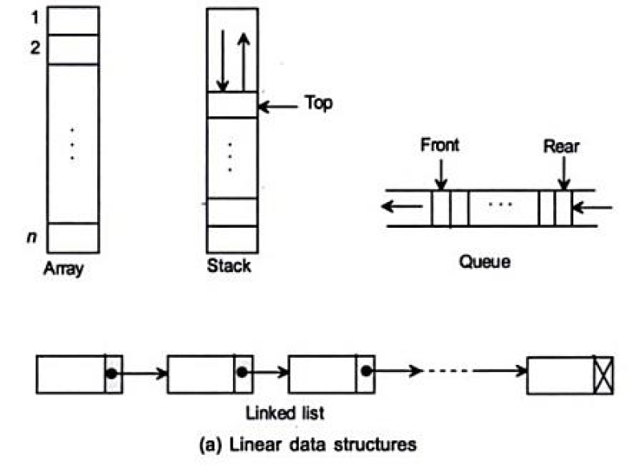
Notes:
Array: collection of same data tyes, data stored in sequence , elements store in continuous memory location
Stack LIFO
Queue FIFO

Slide 37
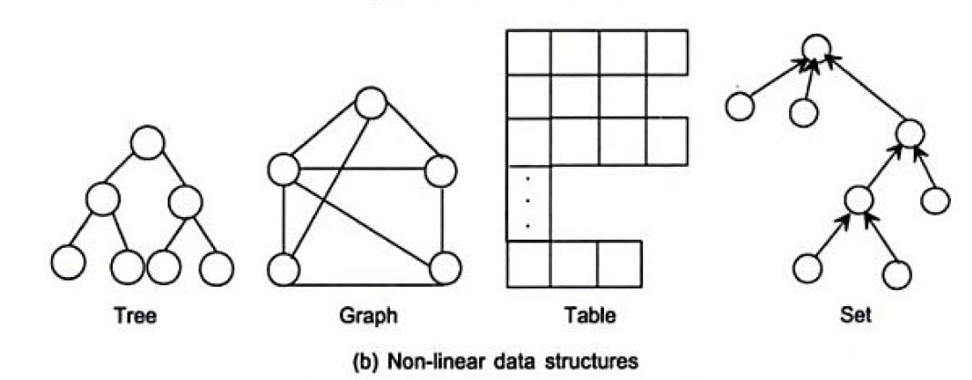

Slide 38
Data Structure Example Applications
1. How does Google quickly find web pages that contain a search term?
2. What’s the fastest way to broadcast a message to a network of computers

Slide 39
Data abstraction
Abstraction? Anything that hides details & provides only the essentials.
Abstract Data Type
An abstract data type(ADT) is a data type that is organized in such a way that the specification of the objects and the operations on the objects is separated from the representation of the objects and the implementation of the operations.
We know what is does, but not necessarily how it will do it.
Notes:
It is user defined data type
User define the value storage memory size , loc
Data and associated operations defined init there is no implementation of data.

Slide 40
Abstract Data Type
A mathematical model of the data objects that make up a data type as well as the functions that operate on these objects.
An abstract data type (ADT) specifies behavior, but not implementation
It specifies the type of data stored and the operations that supports the data
Notes:
An implementation uses a particular low-level data type to implement the desired behavior.

Slide 41
ADTs
While designing ADTs, a designer has to deal with two types of questions:
(i) What values are in the domain? What operations can be performed on the values of a particular data type?
(ii) How is the data type represented? How are the operations implemented?

Slide 42
ADTs
ADTs specification answers the ‘what’ questions. Specification is written first.
ADTs implementation answers the ‘how’ questions. Done after specification.
Users & Implementers.
Users of an ADT need only know the specification …. no implementation details.← advantage
Programmer (Implementer) who implements ADT is concerned with specification, representation and implementation.

Slide 43
ADTs
Elements
Structure
Domain
Operations
User of an ADT
must know
only this
Specification
Implementer must
know all these.
Representation
Implementation

Slide 44
How to analyse an algorithm
First criteria to analyse any algorithm is ‘TIME’
Second is ‘SPACE’
Or
Algorithm complexity:
It is the function which gives running time and space requirements of an algorithm
Example (swap function algo)*

Slide 45
Example:
Algorithm swap (a , b)
{
temp = a;
a = b;
b = temp ;
}
Time function:
F(n) = ???
Notes:
3

Slide 46
For space analysis :
We have 3 variables in program
A
B
Temp
So S (n)=??
Notes:
3

Slide 47
Frequency count method:
Algorithm Sum (A,n)
{
S=0;
For( i=0; i<n ;i++)
{
S=S+A[i];
}
Return S;
}

Slide 48
Algorithm complexity
Time complexity
F(n)=2n+3
O(n) → degree of polynomial/order
Space complexity
S(n)=n+3
O(n) → degree of polynomial/order

Slide 49
2.
Algorithm Add (A,B, n)
{
For (i=0; i<n; i++)
{
For (j=0; j<n; j++)
{
C[i,j]= A[i,j]+B[i,j];
}
}
}

Slide 50
Time complexity :
F(n)= 2n^2 +2n +1
O(n^2)
Space Complexity
S(n) = 3n^2 +3
O(n^2)

Slide 51
What is time and space complexity of following algorithm :
Algorithm Multiply (A,B, n)
{
For (i=0; i<n; i++)
{
For (j=0; j<n; j++)
{
C[i,j]= 0;
For (k=0; k<n ;k++)
{
C[i,j]=C[i,j]+A[i,k]*B[k,j];
}
}
}
}

Slide 52
Time complexity :
F(n)= 2n^3+3n^2+2n+1
O(n^3)
Space complexity
S(n)=3n^2+4
O(n^2)

